Slide 1
Reactions 14
Very high energy phenomena
Deuteron stripping

Slide 2































Slide 3










































Slide 4


















Slide 5




























Slide 6
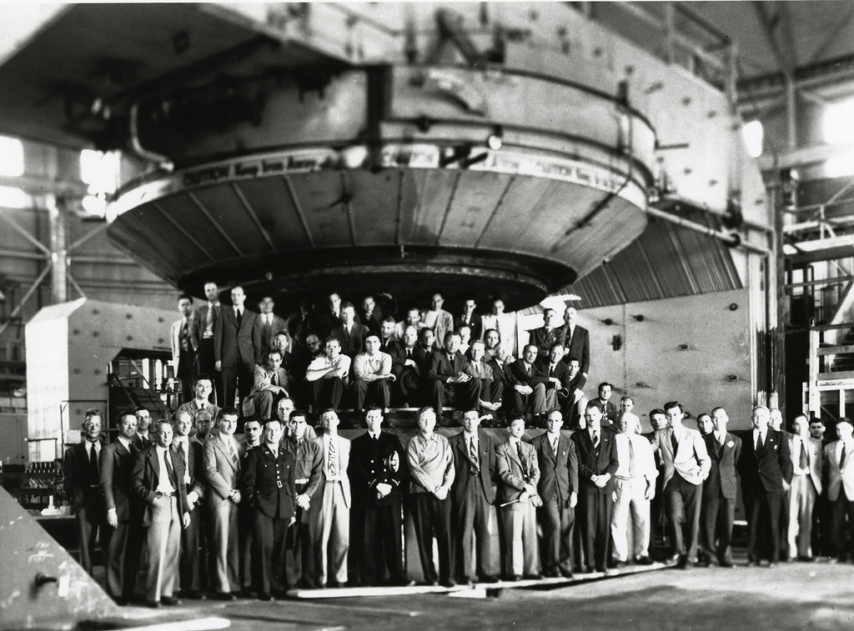

Slide 7
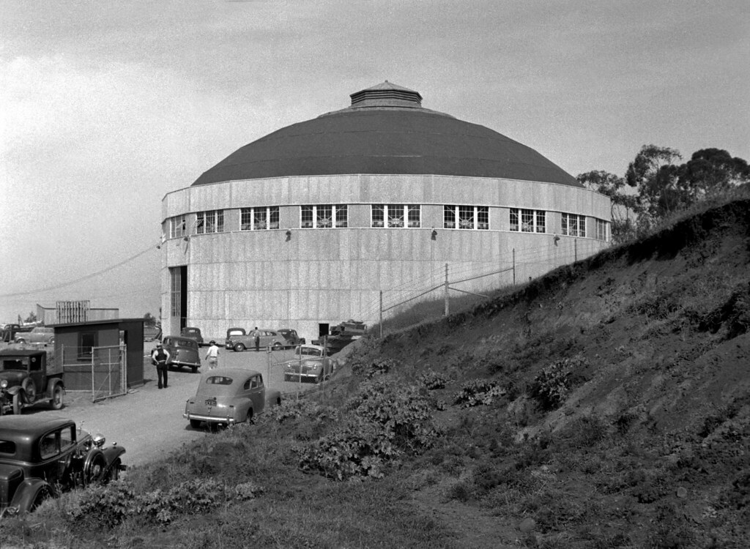
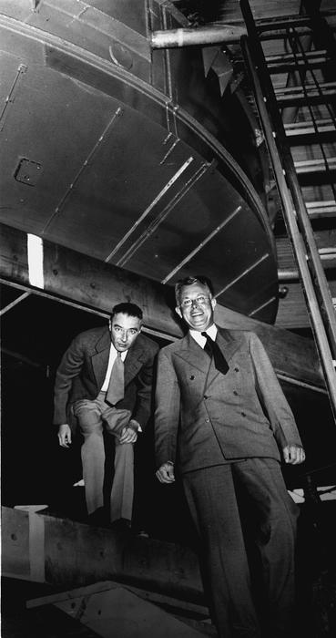

Slide 8
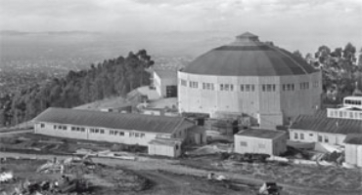

Slide 9
























Slide 10



























Slide 11







